Slide 1

JOOMLA AND CMS
Athma Joseph
MCA S5
Don Bosco College

Slide 2
Content Management System
In simple words, content management system is a system that manages content.
What is Content?
Content is any type or unit of digital information
What is the CM System ?
A CMS is a tool that enables us to create, edit, delete and finally publish in a varying format a variety of content as well as site maintenance from a central page.

Slide 3
Benefits of CMS
• Website is easy to update.
• Site can be updated from anywhere.
• No need to pay someone to keep our Site Updated.
• Availability of site modules and templates.
• An open source community (for support).
• Design changes are easy.
• Content and structure can easily be adapted.
• Content is well organized and searchable.

Slide 4
Example:
Drupal (www.drupal.org)
Wordpress(www.wordpress.org)
Joomla (www.joomla.org)

Slide 5
What is Joomla
Joomla is a free open source framework allows you to build web sites and powerful online applications.
Joomla is written in php for managing content on the web and uses a mysql database to store content.

Slide 6
Why to Use Joomla! ?
Its FREE
One Click Installation
Cross Platform for client: LINUX and Windows for hosting
Pro-Active Support
Joomla! Teams and Community members.
Simplicity
Flexibility
Robust
Extremely stable core infrastructure
Extensible
3rd Party Extension and Plug-In capabilities
Dynamic Content
MySQL database driven

Slide 7
Where Joomla is use
Online Magazines NewsPaper and Publication
Ecommmerce and online Reservation
Government application
Corporate website
Small business website

Slide 8
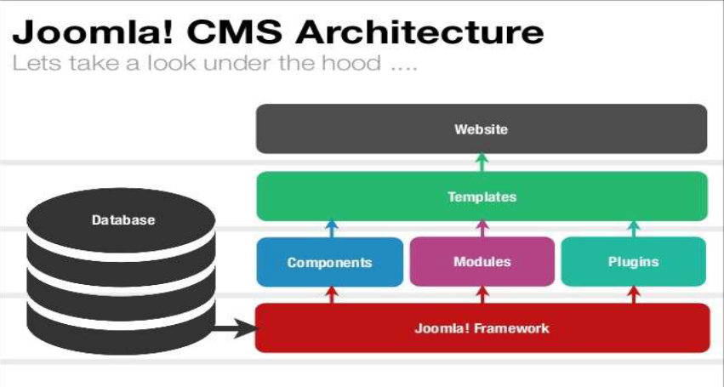
Joomla cms Architecture

Slide 9
JOOMLA INSTALLATION ON
WINDOWS

Slide 10
Joomla system requirment
XAMPP
X-Operating System(Linux or Windows or Mac OS or Solaris )
Apache - Web Server
Mysql - Database
PHP - Programming Language
Perl - Programming Language

Slide 11
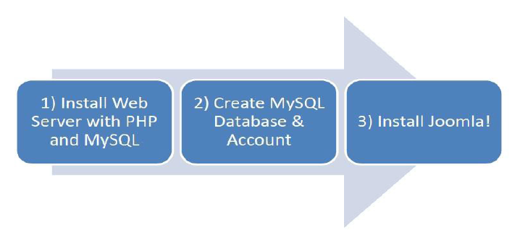
Installation of Joomla

Slide 12
Steps:
Install XAMPP
http://www.apachefriends.org/download.php?xampp-win32-1.7.3.exe
unzip joomla into your xampp's www folder (eg :C:\xampp\htdocs\joomla
start xampp
Create database “joomla”
open a browser window and go to http://localhost/joomla
follow the on screen prompts to install joomla

Slide 13
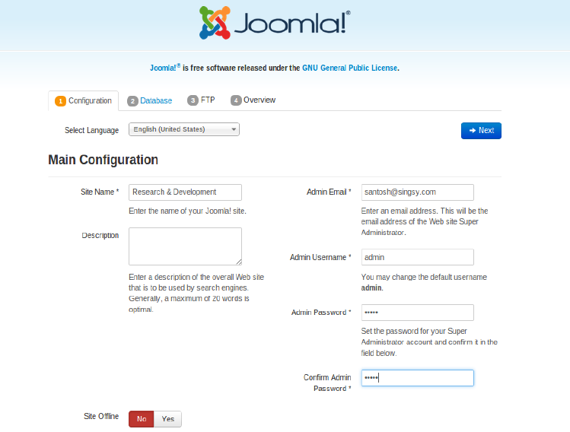

Slide 14
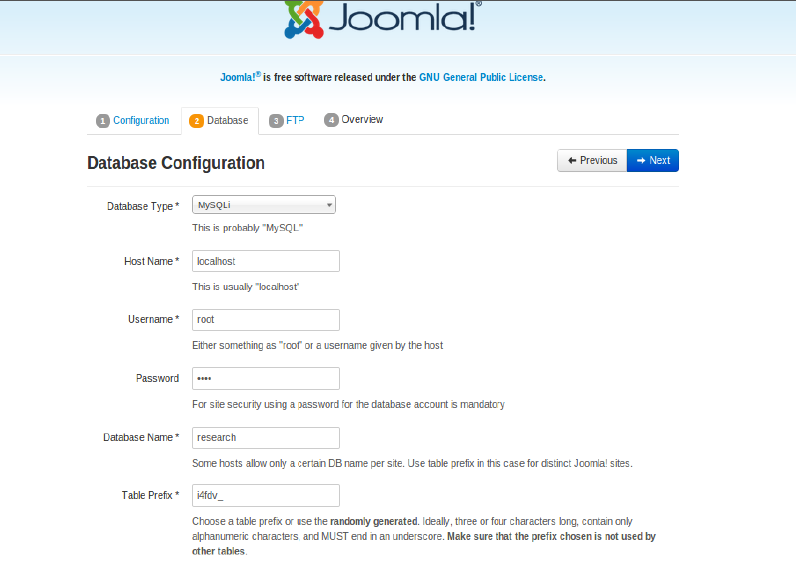

Slide 15
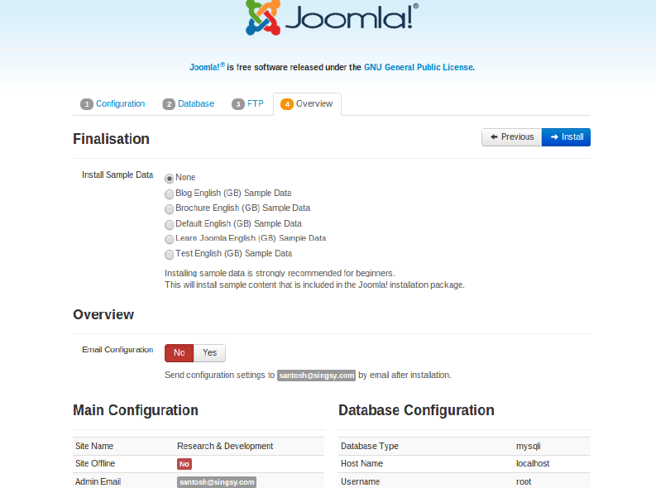

Slide 16
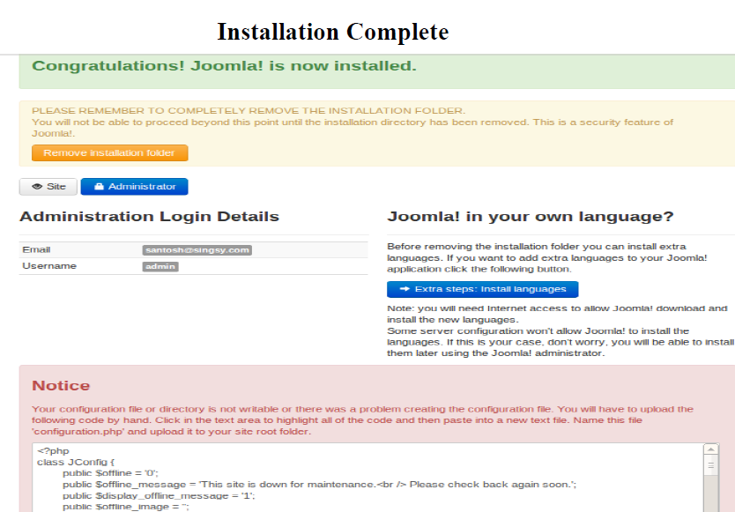

Slide 17
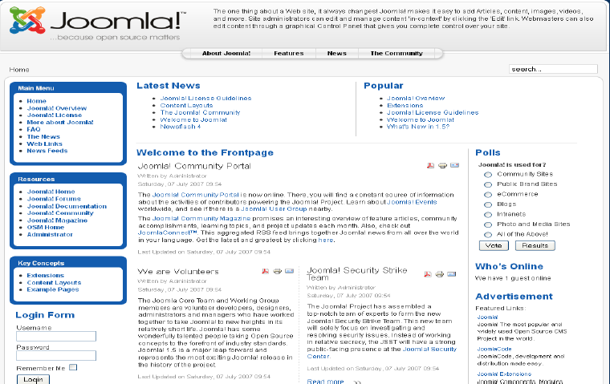
Front End

Slide 18
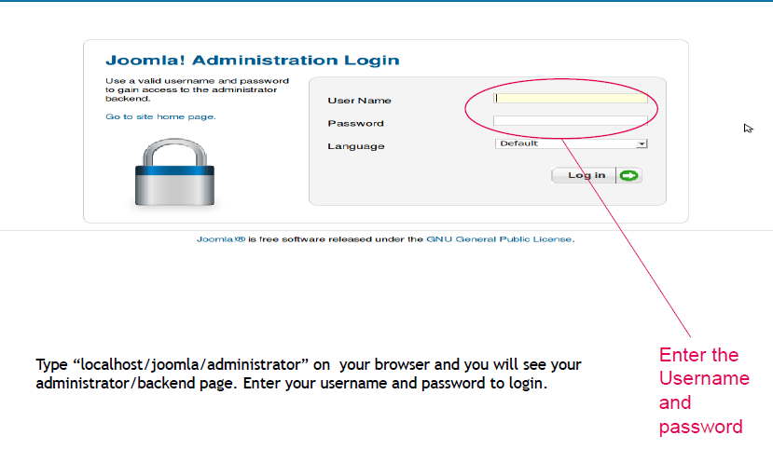
Administrator Section

Slide 19
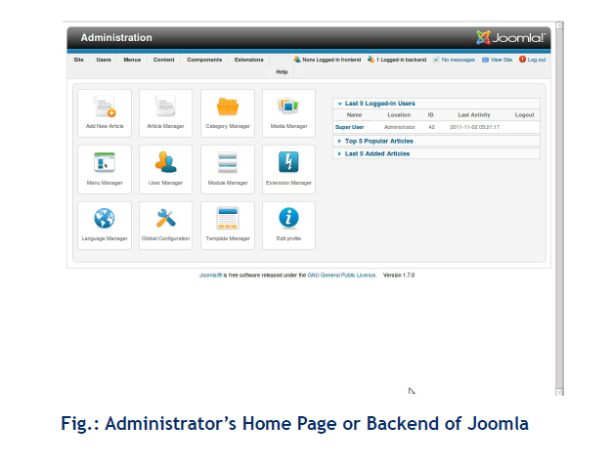
Back End

Slide 20
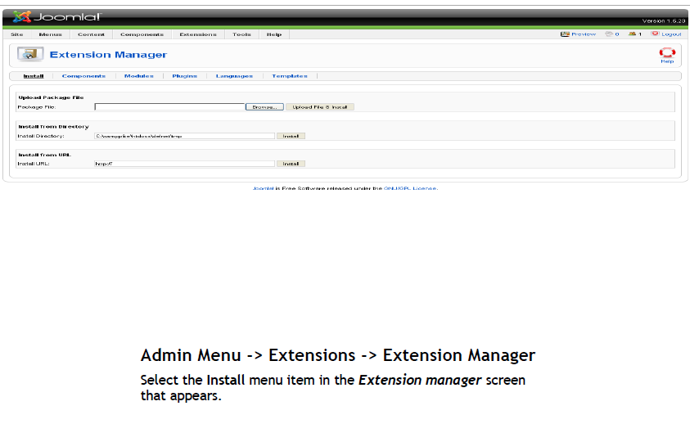
Joomla Extensions

Slide 21
Templates In Joomla
A template is basically the design of your Joomla! Powered website.
With a template you can change the look and feel of your website.
-Admin head menu > “Extensions” >”Template Manager”

Slide 22
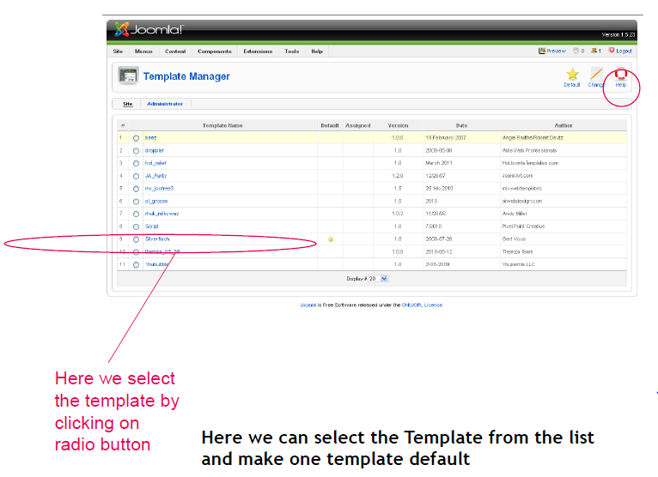

Slide 23
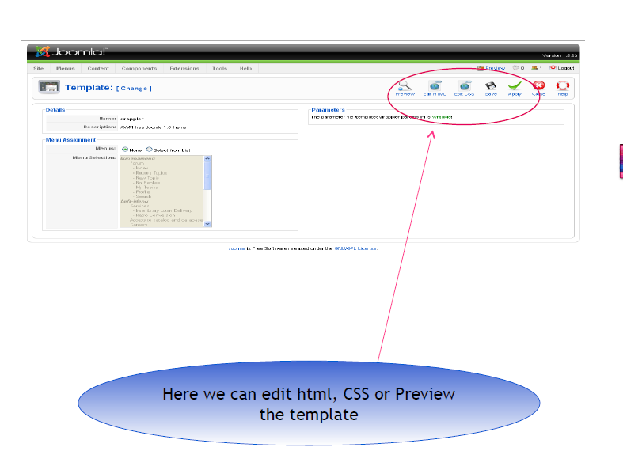

Slide 24
ADVANTAGES
No need to know new interface: Because everything is on browser.
Multiple user can update website
One change can be reflected through out the website.
Support: Joomla.org has a huge selection of development tools and tutorials available for users.
Joomla allows us to create Simple sites, Complex sites, Custom applications and Specialized sites.

Slide 25
DISADVANTAGES
Beginner to Intermediate Usability: Joomla was designed mainly for simple websites and blogs, and for people with only some knowledge of building. This means that it does not have much advanced functionalities for those looking to truly customize complex sites.
Security: Every site in Joomla will use its own login details which makes the work easier but the site less secure.
Resources: The system and sites can use a large amount of server resources comparable to other CMS solutions

Slide 26
FUTURE SCOPE
Joomla for normal user
You can use Joomla to power your website for any purposes
Joomla for developer
You can develop extensions for Joomla either for free or
commercial

Slide 27
Conclusion
Joomla is very easy to operate for technical and non technical person

Slide 28
REFERENCES
1. XAMPP: http://www.apachefriends.org/en/xampp.html
2. CMS: http://Content management system - Wikipedia, the free encyclopedia.htm
3. Joomla: http://www.joomla.org/

Slide 29
ANY QUERIES
?

Slide 30

Athma Joseph

